Slide 1
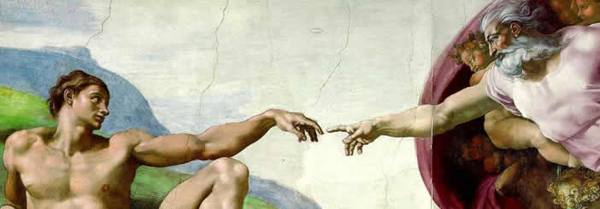
What Caused the Renaissance?
Skill: Organisation and Communication

Slide 2
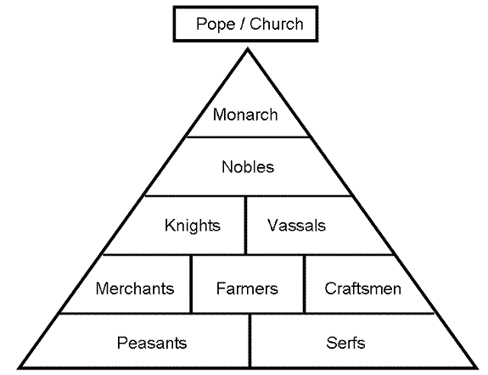
Look carefully at this source? Who would be unhappy with this structure? What could they do?
Click on the image to enlarge it

Slide 3
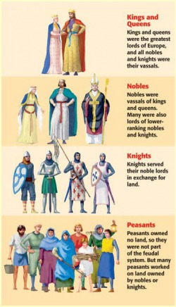

Slide 4
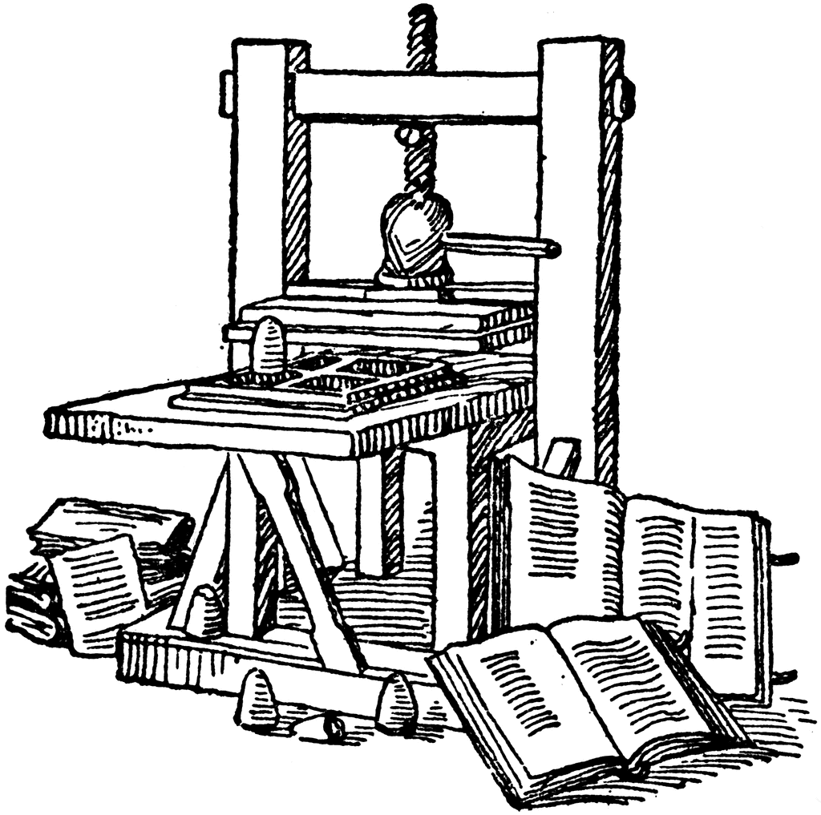
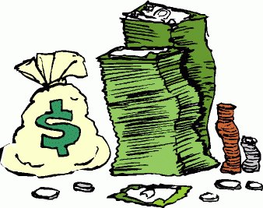
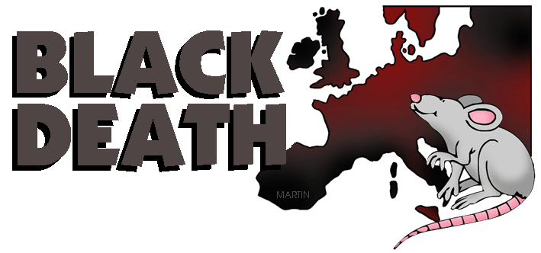
What would happen if more people were to become literate?
Which people would want the feudal social structure to change? / Trade / get richer
What would it take to weaken the influence of the Catholic Church?

Slide 5
What really caused the Renaissance?
In Pairs you must now sort out the causes of the Renaissance into Long Term, Short Term Causes.
THINK: Which of these causes are the most important? Are there events that were not needed, or were they all important?

Slide 6
The Fall of Constantinople The scribes of Constantinople preserved Greek ideas when Europe was in the Dark Ages. They kept the scrolls of Aristotle, Socrates, and other Classical writers in libraries. In 1453 Constantinople fell due to invasions from the Muslims. The scholars fled to Western Europe with the Greek scrolls. Most of these scrolls went to Italy. About this same time one of the most important inventions was made | Revival of Trade As a result of the Crusades Europeans were exposed to exotic Asian goods during the Crusades. Trade between Europe and Asia increased and was dominated by Italy. There was a trade organization in Northern Europe called the Hanseatic League that regulated trade (like today’s trade organizations). Trade fairs were held all over Europe. First there was bartering, but eventually bills and coins were developed again. Manufacturing, banking and investment developed in Europe. Ideas and technology were also shared | Problems within the Church The Church had many problems during this time. In the late 1200's monarchs started to gain more power and challenge the church. Phillip IV of France won the right to tax the clergy and set up the election of a French Pope. The bubonic plague also brought trouble. There was a split in the church as two or more popes fought over power. Powerful preachers started to challenge the Church saying that the true will of God is in the bible. They translated the Bible into vernacular languages so that the people could read it, and called for reforms.
The Black Death Begins (1348) The Black Death killed an estimated 1/3 of all Europeans (about 25 million people), thus creating a great demand for labour. People demanded – and were paid more – for their labour, which gave people more economic power. Sometimes there were uprisings against the wealthy. People also lost faith in the Church due to such a catastrophe, which lead to a loss in Church power and importance | The invention of the printing press In 1440 the printing press was invented which allowed these old scrolls be printed. The printing press was a powerful tool. It allowed ideas to be shared and spread rapidly. The Greek and Roman writings that came in from Constantinople were printed and spread across Europe. | The Growth of Nations Kings and Queens grew more powerful due to the large number of nobles, knights, and landowners dying or spending their money on the Crusades. The Church also grew more powerful. This allowed for control over large areas, which would eventually become nations.
The Crusades By 1000 the Christian ‘Holy Land’ (Palestine) was controlled by the Muslim Turks. European Christians waged holy wars against them to regain the Holy Land, so Christians could make safe pilgrimages. The Crusades lasted until 1291 and were eventually lost by the Christians, but the influence on Europe was powerful. Wealthy landowners (and their private armies) who had paid for the Crusades and/or died in the conflicts allowed for kings and queens to grow more powerful. The church grew more powerful as well. Trade and the sharing of ideas grew between Asia and Europe | Decline of Feudalism 1200’s – 1400’s The decline of feudalism, which was the basis of life during the medieval period, greatly contributed to the rise of Renaissance. Due to development of trade and commerce during this period, there was great increase in prices which greatly benefited the craftsmen, merchants and cultivators. As the feudal lords could not in­crease their rents they were forced to borrow to maintain themselves. As the feudal lords were not able to repay the debts they were often obliged to sell off their lands. This gave a serious setback to feudalism and manorial life. All this paved the way for the Renaissance. | New Wealth In the middle of the fourteenth century the Black Death swept across Europe, killing perhaps a third of the population. While devastating, some of the survivors found themselves better off financially and socially, with the same wealth spread among fewer people, and better potential for climbing the social ladder. These people were different from the medieval way of thinking. They begin to focus more on self-improvement, the world, and education. They educated their children and had them read the Classics. Rather than emphasis the medieval idea that man is terrible and sinful, they emphasized the idea that man was created in God’s image.

Slide 7
Long Term Causes | Short Term Causes
The Crusades | The invention of the printing press
Revival of trade | The Fall of Constantinople
Growth of Nations | New Wealth
Problems within Church | The Black Death Begins (1348)
Decline of Feudalism 1200’s – 1400’s

