Slide 1
Sparta vs. Athens
Political Systems

Slide 2
Sparta
Totalitarianism: it is a form of government that uses force and power to rule a people. This form of culture had its roots in the ancient Greek city-state of Sparta.

Slide 3
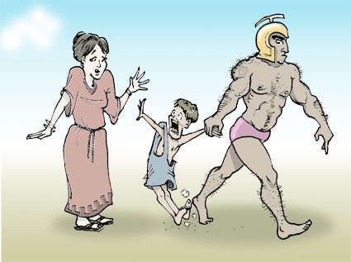
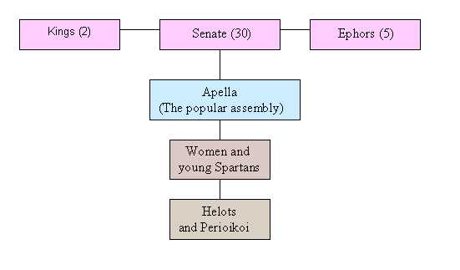
Totalitarian Sparta
Within Sparta there existed three groups: slaves, known as Helots; Spartan females, who were taught to be fit, brave, and patriotic; and Spartan males, all of whom became warriors.
Newborn males judged to be weak were left to die of exposure.
At the age of seven, boys left home to live in barracks and receive military training from older boys.
Boys went barefoot, wore minimal clothing (even in winter), practiced all forms of athletics, and received military instruction.
They married at age 20 but continued to live in the barracks.
The Helots provided the necessary food and labor for Spartan males and females.

Slide 4
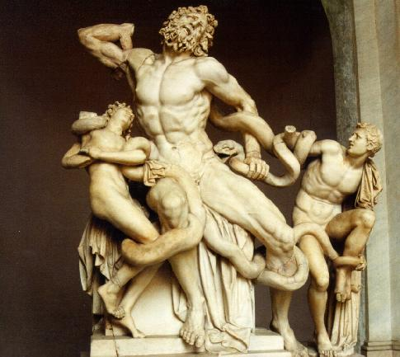
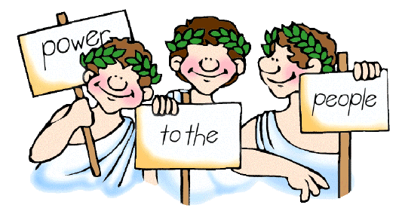
Democratic Athens
In Athens all citizens participated in Athenian governmental activities.
All citizens were equal before the law and participated in the government.
Slaves and women, however, were not allowed citizenship.
Athenians eventually abolished slavery and developed a direct democracy where citizens chose the members of the powerful Assembly.
Athenian youth were encouraged to develop artistic and intellectual talents to such a degree that historians refer to their developments in the arts and politics as a “Golden Age.”

Slide 5
“The fundamental motif through all the centuries has been the principle that force and power are the determining factors. All development is struggle. Only force rules. Force is the first law. . . . Only through struggle have states and the world become great. If one should ask whether this struggle is gruesome, then the only answer could be—for the weak, yes, for humanity as a whole, no. Instead of everlasting struggle, the world preaches cowardly pacifism, and everlasting peace. These three things, considered in the light of their ultimate consequences, are the causes of the downfall of all humanity.”

Slide 6
“We hold these truths to be self evident, that all men are created equal, that they are endowed by their Creator with certain unalienable Rights,* that among these are life, liberty and the pursuit of happiness; that to secure these rights Governments are instituted among Men, deriving their just powers from the consent of the governed.”
Discuss: unalienable rights and the meaning of “just powers from the consent of the governed.”

