Slide 1
Analyzing Cultural Geography
Parts taken from the 2012 AP Princeton Review Human Geography

Slide 2
Components of Culture
Art
Architecture
Language
Music
Film and Television
Food
Clothing
Social Interaction
Religion
Folklore
Land Use

Slide 3
Cultural Landscape
Sign and symbols can be seen within the different components of culture and can be used to understand that place’s cultural background and heritage
Most things in the cultural landscape are products of cultural synthesis(syncretism)
The blending together of two or more cultural influences

Slide 4
Art
Different art forms are signs of a cultural imprint on the landscape
Art can be an identifier of groups of people or as a source of local pride

Slide 5
Architectural Concepts
Within the built environment of the human landscape, there are a number of architectural forms that are the products of cultural influence
There is
Modern and contemporary architecture
Traditional architecture

Slide 6
Modern Architecture
Architecture developed in the 20th century that expresses geometric designs

Slide 7
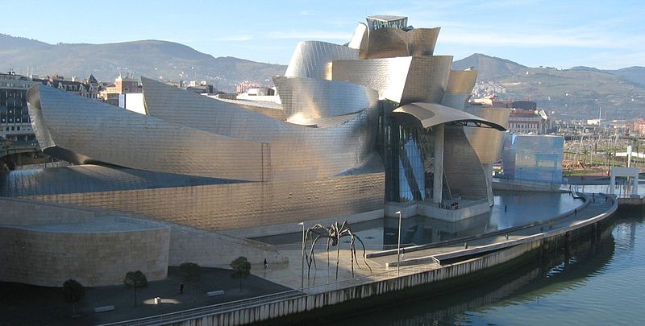
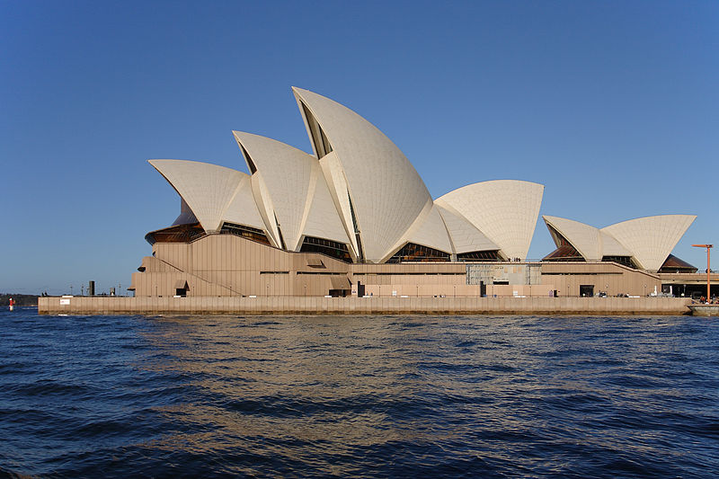
Contemporary Architecture
Uses curvature
Postmodern is a category of contemporary architecture that abandons the use of blocky rectilinear shapes in favor of using wavy, crystalline, or bending shapes
Contemporary architecture can feature green energy technologies, recycled materials, or non-traditional building materials

Slide 8
Religious Architecture Covered
Christian
Hindu
Buddhist
Islamic
Judaic

Slide 9
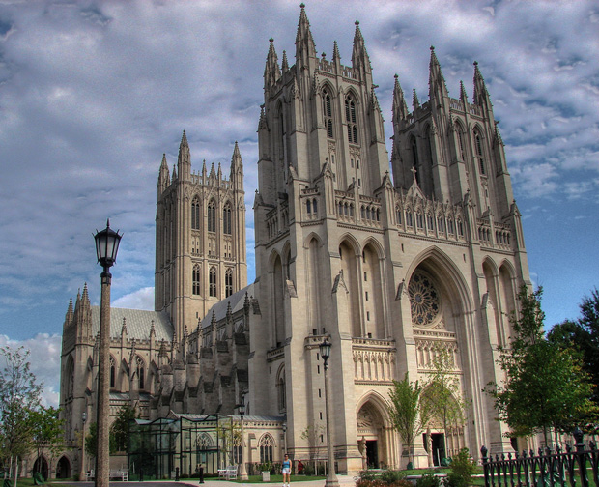
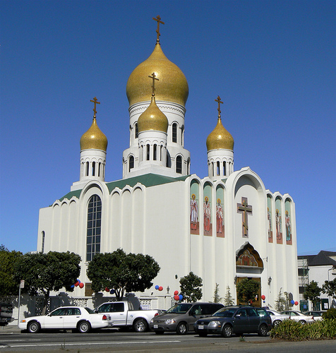
Christian Architecture
Usually have a central steeple or two high bell towers in the front of the building
Steeple is typical of smaller churches
Bell tower is typical of larger churches
Older churches, cathedrals, and basilicas feature a cross-shaped floor plan

Slide 10
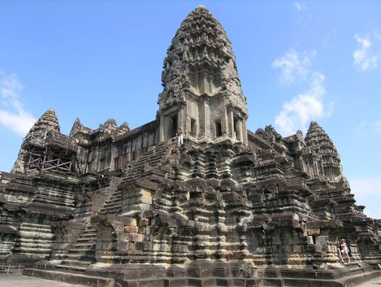
Hindu Architecture
Rectangular-shaped main body and have one or more short towers of carved stone
Often feature stepped sides and display carvings of the heads and faces of deities

Slide 11
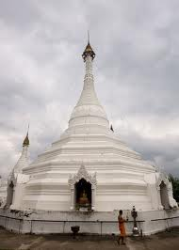
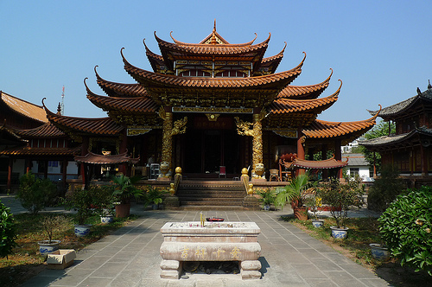
Buddhist Architecture
Temples and shrines vary depending on which Buddhist tradition is followed in the region
In Nepal and Tibet, a temple can be a stupa, with a dome or tower featuring a pair of eyes
In East Asia, the tower-style pagoda with several levels that each feature winged roofs extending outward is common
In China and Shinto Japan, there are one and two story buildings with large, curved, winged roofs
Temples are often guarded by large lion statues
Temples in Southeast Asia have several towers with thin pointed spires that point outwards at an angle

Slide 12
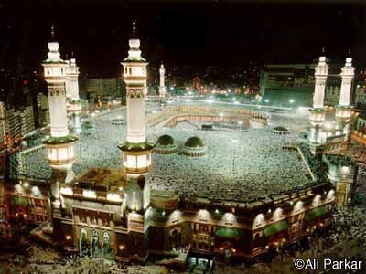
Islamic Architecture
Many mosques have central domes
A mosque has one or more minarets, narrow towers that are pointed on the top
Almost all mosques are built on an angle that places the main prayer area toward Mecca

Slide 13
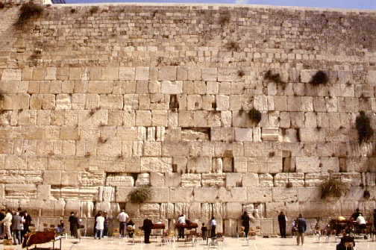
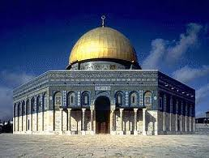
Judaic Architecture
There is not a common architectural design of synagogues
Most holy place in Judaism is the Western Wall(Wailing Wall) next to the Dome of the Rock

Slide 14
LANGUAGE

Slide 15
Language Defined
Organized system of spoken words by which people communicate with one another with mutual comprehension (Getis, 1985).
Languages subtly gradate one to another. Dialects and other regional differences may eventually lead to incomprehensibility - a new language.
Migration and Isolation explain how a single language can later become two or more.

Slide 16
Geographer’s Perspective on Language
Language is an essential element of culture, possibly the most important medium by which culture is transmitted.
Languages even structure the perceptions of their speakers. Attitudes, understandings, and responses are partly determined by the words available.
Languages are a hallmark of cultural diversity with distinctive regional distributions.

Slide 17
Language Distribution indicates
History and conquest
Isolation or integration of cultures
Migration of peoples
Economic Domination of certain cultures
Influence of wealth and technology
Political Divisions (country boundaries)
Physical geography barriers (mts., deserts)

Slide 18
Language
The United States does not have an official language
Some states have English-only laws and provisions
Much of the United States is monolingual
Some states such as California have a large multilingual population and have made provisions to provide services in multiple languages
Canada is bilingual
English and French
The Netherlands and South Africa are examples of multilingual nations
Netherlands- Dutch, English, French, German
South Africa- English, Afrikaans, and one or more native African languages(Xhosa, Sotho, Zulu, etc…)
In a linguistic region, the way a language is spoken can sound different
English in Australia; same language, but different word sounds and vocabulary
Within countries, dialect can change from region to region

Slide 19
Cockney English
Cockney English is the language of the working-class areas of the East London docklands and surrounding neighborhoods
Thought to be very influential in the formation of Australian English
Cockney rhyming slang is an odd but humorous use of code phrases to describe everyday situations
“going up the apples” means going up the stairs; stairs rhymes with pears, apples and pears, therefore stairs is replaced with apples

Slide 20
Pidgin, Creole, and Patois
Pidgin languages are simplified versions of the language that use key vocabulary words and limited grammar
Can evolve into their own language groups over time
French Creole in Haiti; incorporates French with African dialectal sounds and vocabulary
Patois is formed by local or immigrant linguistic syntheses

Slide 21
Lingua Franca
French has been a language used to bridge the linguistic gap between people of different national heritage
That is why “franca” is used
The global lingua franca is English as all media is dominated by the English language

Slide 22
Major Language Families and Dynamics
Indo-European(2.5 billion people)
Sino-Tibetan(1.4 billion people)
Afro-Asiatic(284 million people)
Austronesian(244 million people)
Dravidian(203 million people)
Niger-Congo(172 million people)
Altaic(128 million people)
Japanese(122 million people)
Korean(67 million people)
Each language family can be broken down into language groups
Some can be broken down into language subfamilies and then into smaller language groups
The Indo-European language family is originated from prehistoric migrations from the Indian subcontinent into Europe

Slide 23
The Anatolian and Kurgan Theories
Two competing theories regarding the origins of European language
Each have a hearth, or originating point
Anatolian Theory
A group of migrants from the Indian subcontinent and their language were concentrated in the peninsula that makes up most of present-day Turkey, known as Asia Minor or Anatolia
From there, a large migration crossed into continental Europe and spread outward into Europe. These people were farmers and pastoralists expanding slowly
Kurgan Theory
The same group of migrants from the Indian subcontinent instead made their way into Central Asia, and then migrated across the Eurasian steppe into Central and Western Europe
These people were a war-like people expanding and conquering
Almost all Europeans are genetically derived from populations that lived in the Indian subcontinent

Slide 24
Food
Continental cuisine is the formal food traditions that emerged from mainland Europe in the 1800s
Nouvelle cuisine is the contemporary form of the continental styles mainly from France, Spain, and Italy
Fusion cuisine is when more than one global tradition is incorporated in a dish

Slide 25
Religion
Also referred to as “belief systems” by social scientists
Universalizing religions accept followers from all ethnicities worldwide
Ethnic religions only accept members of a specific culture group
All organized religions have one or more books or scripture, said to be written of divine origin
Compromising religions have the ability to reform or integrate other beliefs into their doctoral practices
Fundamentalist religions have little or no interest in compromising their beliefs or doctrine and strictly adhere to scriptural dictates

Slide 26
World Religions
Three major traditions of belief systems-
Animist Tradition: Various ethnic, tribal, and forms of nature worship
Geographically unrelated
Have common themes, worship practices, and morality tales
Hindu-Buddhist Tradition: Hinduism, Buddhism, Jainism
Began with Hinduism 5,000 years ago
Polytheistic denominations spread through Asia by the 1200s C.E.
Many levels of existence, the highest being nirvana, where a being could achieve total consciousness or enlightenment
One’s soul is reincarnated repetitively into different forms
Karma determines the outcome of reincarnation into a lower, similar, or higher form of existence in the next life
Abrahamic Tradition: Judaism, Christianity, Islam
Share similar scriptural descriptions of the earth’s genesis and the story of Abraham as a morality tale of respect for the will of God or Allah
Monotheistic; can be sub-deities such as saints, angels, and archangels
Prophecy that predicts the coming or return of a messianic figure that defeats the forces of a satanic evil for souls of followers

Slide 27
Native American
Who?
The pre-Columbian civilizations in the Americas
When?
From 18,000 years ago(last period of glaciation)
Where?
From Alaska to the Tierra del Fuego
Scripture
None
Spiritual interpretations are delivered by shamans(“medicine men”) who lead worship and religious rites
Doctrine
Depends upon tribal following
Prayers to sun, moon, and spirits are common
Denominations
Hundreds of different tribal interpretations
Historical Diffusion
By migration diffusion through the Americas

Slide 28
Buddhism
Who?
Ideological following that rejected the caste system and other Hindu practices
When?
2,500 years before present
Where?
Hearth in the Gangetic Plain of North Central India and spread throughout Asia
Scripture
Early Hindu texts combined with the Tipitaka(Pali Canon)
Tipitaka contains the life and teaching of Siddhartha Gautama, the founder of Buddhism
Doctrine
Different doctrinal texts including Tao Te Ching
Main difference from Hinduism is the belief that nirvana can be achieved in one lifetime
This is through an understanding of the effects of suffering on human life and the following of a “Middle Way” or non-extremist pathway toward enlightenment

Slide 29
Buddhism(continued…)
Denominations
Three distinct traditions broken into smaller regional and philosophical denominations
Tibetan(Vajrayana)
Universalizing, accepting westerners into their community but uncompromising in their beliefs
Southeast Asian(Therevada)
Less universalizing, does not compromise their traditions
East Asian(Mahayana)
Both universalizing and compromising
EX: Shinto, Confucianism, and Taoism
Historical Diffusion
Tibetan Buddhism relocated across the Himalayas and Tarim Basin desert to Siberia and Mongolia
Therevada relocated from Sri Lanka across the Bay of Bengal to Southeast Asia
Mahayana across the Himalayas to Eastern China

Slide 30
Hinduism
Who?
South Asians and some Southeast Asians
When?
Earliest forms; 7,500 years ago
Where?
Mainly India, but parts in Indonesia, London, Fiji, and South Africa
Scripture
Vedas, Upanishads, Bhagavad Gita, and other early Sanskrit religious texts
Doctrine
Work continuously with multiple reincarnations to achieve nirvana
Practice of temple based worship and festivals to praise particular supreme gods
Several writings depict historical moral traditions and practices
Denominations
Various are based upon cults to deities
Based on caste system
Historical Diffusion
Expansion diffusion from Hindu hearth in Northern India
Relocation diffusion across the Bay of Bengal to Southeast Asia and to Indonesia

Slide 31
Caste System In India
Hindu scriptures believe in a cosmology(belief in structure of the universe) in which there are several levels of existence, from the lowest animal forms to human forms then higher animal forms which are considered sacred by Hindus, such as cattle, elephants, and snakes
The levels are known as chakras
As a soul is reincarnated it can be elevated to a higher chakra if the soul has a positive karmic balance
Once someone is born into a caste, they are there for life, no matter how rich or poor he becomes
Five levels(varna) within the human chakra that compose the Hinduistic Caste System

Slide 32
The Caste System
Brahmans
The priestly caste responsible for religious worship
Some can be selected as high government officials, others may become monks
Kshatriyas
The aristocratic and warrior class
Many are land owners, government leaders, or wealthy businessman
Vaisyas
The merchant class
Doctors, lawyers, accountants, etc…
Sudras
Tradespeople and farmer class
Broken up into hundreds of sub-classes or jati
Dalits
The “Untouchables”
Street sweepers, sewer cleaners etc…

Slide 33
Conclusion to the Caste System
Since India gained independence in 1948, its government has initiated efforts to eliminate the caste structure in Indian society
Opening schools to lower caste members, etc…
Caste differences in Indian cities has became minimal, but it is still recognized in rural India
Marriage still has an emphasis on caste, as most traditional parents desire their children to marry according to caste

Slide 34
Judaism
Who?
Jewish community
When?
Over 5,700 years before today. January 1, 2010 is year 5770 on the Hebrew calendar
Where?
Hearth in Israel, peripheral communities in Europe and the United States
Scripture
Torah and Talmud
Doctrine
Varies between groups
Shared between all is the atonement of sins annually during Yom Kippur and Rosh Hashanah
Denominations
Orthodox, Conservative, Reform, and Reconstructionism
Historical Diffusion
The Jewish Diaspora begins in 70 C.E. with the Roman destruction of the temple of Jerusalem, where Jews were forced to other parts of the Empire
Post-WWII era marks the beginning of the Jewish movement to Israel from Europe
Conflicts in 1950s and 1960s caused migrations from North Africa and the Middle East to Israel

Slide 35
Christianity
Who?
Originates in the Roman Empire but not officially recognized until the 4th century with the Edict of Milan
When?
Following begins around 30 C.E.; begins expansion outside the Mediterranean in the 6th century
Where?
Europe, the Americas, Sub-Saharan Africa, Philippines, Austronesia
Scripture
The Bible, divided into the Old Testament and the New Testament
Doctrine
Varies depending on denomination
Usually involve communion practices and baptisms
Denominations
Eastern Orthodox, Armenian, Greek Orthodox, Roman Catholic, Protestant, etc…
Historical Diffusion
From the Mediterranean hearth, Christianity diffused hierarchically to large cities such as Rome and Alexandria
From there missionaries spread the faith to other communities

Slide 36
Islam
Who?
Originates with the people of the Arabian Peninsula along the Red Sea
Particularly Mecca, Median, and Jeddah
When?
Early 600 C.E.
Where?
Asia, the Middle East, West Africa, Oceania
Scripture
Koran, the scriptures received by Muhammad
Doctrine
Haddith, the spoken word of Muhammad
The Five Pillars of Islam
Denominations
Sunni and Shia sects, also further divided
EX: Ismaili Shiite and Wahabi Sunni
Difference is because of the Shia necessity for Imams(religious leaders) that are direct descendants of Muhammad
Historical Diffusion
Islam diffused in all directions quickly
By 700 C.E., all of the Middle East and much of North Africa was adherent to Islam
Further expansion into Europe and Asia during through the 1600s

Slide 37
Islamic States: Theocracy, Sharia, and Secular Governance
Theocracies are where religious leaders hold the higher powers of governance
Some Middle Eastern states are republics or monarchies that abide by Sharia, Islamic law, based on the Koran
Other states are secular
The state is not directly governed in a religious manner
A few examples:
Theocracy- Iran
Sharia States -Saudi Arabia, Kuwait, Yemen
Secular States- Jordan, Iraq, Egypt, Turkey

Slide 38
Syncretic Religions
Religions that synthesize the core beliefs from two or more other religions
EX:
Druze
Christian and Islamic principles
Sikhs
Islam and Hindu principles
Reject caste-system

Slide 39
The Five Pillars of Islam
Moral code for all Muslims
Five Daily Prayers
Call to prayer
Work is stopped and prayer mats are unrolled
Prayer is facing Mecca
Islamic Creed
“There is only one god, Allah, and Muhammad is his prophet.”
Monotheism
Islam believes in the some of the same prophets that Christianity believes in such as Moses, Ishmael, and Jesus
Alms to the Poor
Donate to the poor and sick
Help alleviate poverty, extend health care, and educate children
Observation of Ramadan
A period of spiritual cleansing and repentance for past sins
Fasting during daylight hours
Set on a lunar calender
The Hajj
The pilgrimage to Mecca that must be completed at leas t once during a Muslim’s lifetime
Popular time is during Ramadan

Slide 40
Ethnicity
A complex of genetic heritage and political allegiance embodied in the term ethnicity
Ethnic groups often claim a single identifiable lineage or heritage
Several ethnicities can exist within the same linguistic group, (Welsh, Scottish and English)
Several languages can exist within the same ethnicity
French Canadians (English and French)
South Asian Indians (Hindi, Bengali, English, etc.)
Ethnicity can be modified in migration
Ex: European ethnic groups became Americans

Slide 41
Race
Ethnicity represents the national heritage of an individual
Race refers to the physical characteristics of a common genetic heritage
Researchers categorized racial groups based on a number of variables including skin color, bone structure, and the shape of hair shafts(straight, wavy, curly)

Slide 42
Racial group physiology
Three racial groups emerged from this research
Mongoloid or Asiatic
Tan or yellowish skin tone, small body structure, and straight hair shaft
Caucasian or Indo-European
Light to dark skin tone, medium body type, and wavy hair shaft
Negroid or African
Dark skin tone, medium body shapes, and a curly hair shaft

Slide 43
Environmental Determinism
Human geographers developed the concept of environmental determinism to explain cultural differences around the world
“The former scientific ideology that states a culture’s traits are defined by the physical geography of its native hearth or cultural region”
Friedrich Ratzel, the father of Human Geography, and his students built a large body of research claiming that all aspects of culture were defined by physical geographic features

Slide 44
The Determinism Debate and Possibility
Despite global elimination of slavery in the late 1800s, racism and environmental determination were widely accepted
To change the human perspective, geographers including Carl Sauer opposed the environmental determinists
Possibilism was the revised concept proposed by geographers
This ideology stated that cultures were partially shaped by their environment and resources available to them

Slide 45
Sequent Occupancy
A single place or region, different cultures replace each other over time
When examining cultural landscape, remnants of previous cultural influences remain
EX: New York City; once under British colonial rule, under Dutch rule, under Native American rule

Slide 46
Yugoslavia
Yugoslavia was created as a state during the post-WWI Treaty of Versailles in 1919
This part of the Balkan peninsula contained many overlapping ethnic regions
Following the death of Communist leader, Josep Tito, no individual group or person was in control of Yugoslavia
After his death, Yugoslavians began to revitalize their ethnic and religious arguments
The Croats are Roman Catholic and the Serbs are Eastern Orthodox
In 1989, fighting broke out between these groups
Croats forced Serbs out of Serbian enclaves in Croatia and the Serbs did the same to the Croats
This is the first mention of ethnic cleansing

Slide 47
Genocide
The massive systematic scale of killing people of one ethnic group
EX
Holocaust
Rwanda
Darfur

