Slide 1
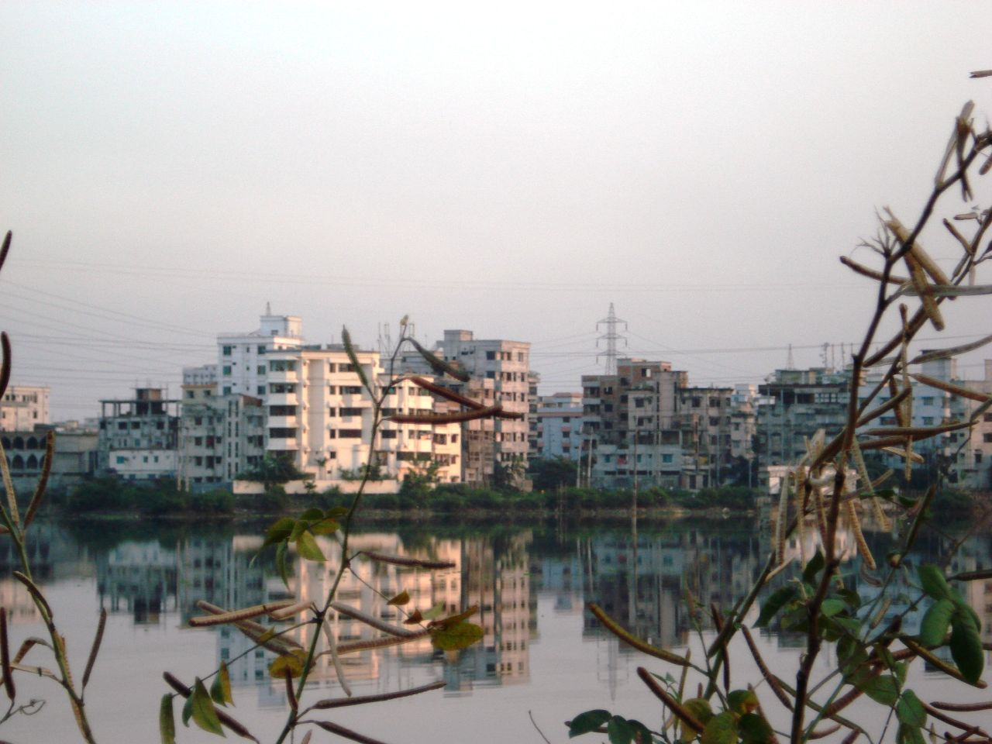

Introduction to Development
Development Indicators

Slide 2
Development Indicators
Development indicators can be divided into two types-
Social- those to do with the quality of life of individuals within a country.
Economic- those to do with the wealth of individuals within the country.

Slide 3
Development Indicators
Development indicators helps us classify countries according to their development.
MEDC- More economically developed country.
LEDC – Less economically developed country.

Slide 4
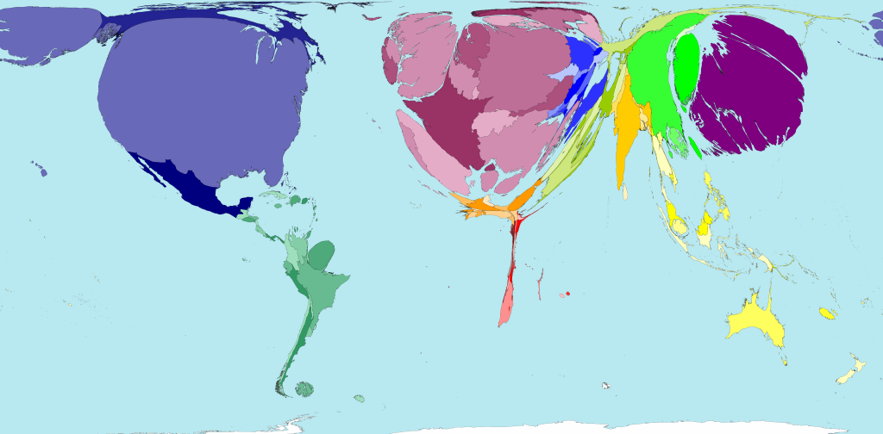
http://www.worldmapper.org/display.php?selected=169
GNP per capita

Slide 5
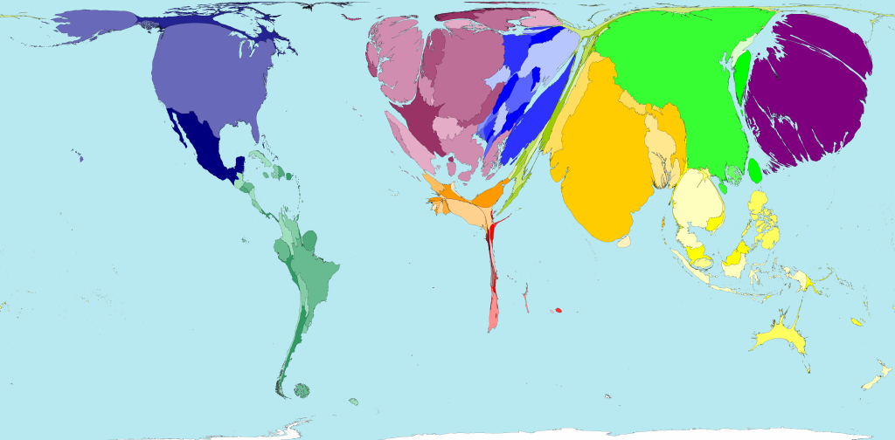
http://www.worldmapper.org/display.php?selected=341
Newspapers per 1000 people

Slide 6
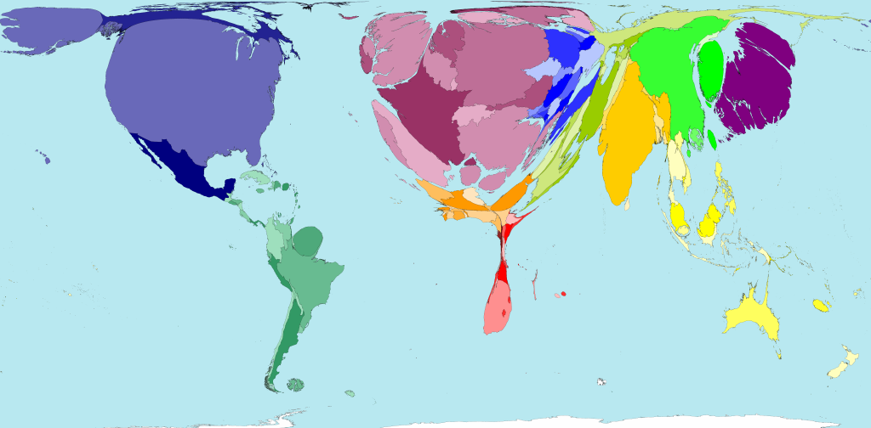
http://www.worldmapper.org/display.php?selected=209
Territory according to secondary education spending

Slide 7

Development Indicators
INDICATOR | TRANSLATION! | WHAT DOES IT TELL US ABOUT A COUNTRY?
GNP per capita | Average earnings per person | Wealth; employment; disposable income; life choices; afford necessities?
Literacy rate | People able to read and write
Infant mortality | Child deaths
People per doctor
Newspapers per 1000 people
TV ownership per 1000 people
Life expectancy | Average number of years people are expected to live
% people employed in farming (Primary industry)

Slide 8
Development Indicators
INDICATOR | TRANSLATION! | WHAT DOES IT TELL US ABOUT A COUNTRY?
GNP per capita | Average earnings per person | Wealth; employment; disposable income; life choices; afford necessities?
Literacy rate | People able to read and write | Education; Employment / wages; political awareness
Infant mortality | Child deaths
People per doctor
Newspapers per 1000 people
TV ownership per 1000 people
Life expectancy | Average number of years people are expected to live
% people employed in farming (Primary industry)

Slide 9

Development Indicators
INDICATOR | TRANSLATION! | WHAT DOES IT TELL US ABOUT A COUNTRY?
GNP per capita | Average earnings per person | Wealth; employment; disposable income; life choices; afford necessities?
Literacy rate | People able to read and write | Education; Employment / wages; political awareness
Infant mortality | Child deaths | Health care; Nutrition
People per doctor
Newspapers per 1000 people
TV ownership per 1000 people
Life expectancy | Average number of years people are expected to live
% people employed in farming (Primary industry)

Slide 10
Development Indicators
INDICATOR | TRANSLATION! | WHAT DOES IT TELL US ABOUT A COUNTRY?
GNP per capita | Average earnings per person | Wealth; employment; disposable income; life choices; afford necessities?
Literacy rate | People able to read and write | Education; Employment / wages; political awareness
Infant mortality | Child deaths | Health care; Nutrition
People per doctor |  | Education; Health care; death rates; life expectancy
Newspapers per 1000 people
TV ownership per 1000 people
Life expectancy | Average number of years people are expected to live
% people employed in farming (Primary industry)

Slide 11
Development Indicators
INDICATOR | TRANSLATION! | WHAT DOES IT TELL US ABOUT A COUNTRY?
GNP per capita | Average earnings per person | Wealth; employment; disposable income; life choices; afford necessities?
Literacy rate | People able to read and write | Education; Employment / wages; political awareness
Infant mortality | Child deaths | Health care; Nutrition
People per doctor |  | Education; Health care; death rates; life expectancy
Newspapers per 1000 people |  | Literacy; Disposable income; Political awareness
TV ownership per 1000 people
Life expectancy | Average number of years people are expected to live
% people employed in farming (Primary industry)

Slide 12
Development Indicators
INDICATOR | TRANSLATION! | WHAT DOES IT TELL US ABOUT A COUNTRY?
GNP per capita | Average earnings per person | Wealth; employment; disposable income; life choices; afford necessities?
Literacy rate | People able to read and write | Education; Employment / wages; political awareness
Infant mortality | Child deaths | Health care; Nutrition
People per doctor |  | Education; Health care; death rates; life expectancy
Newspapers per 1000 people |  | Literacy; Disposable income; Political awareness
TV ownership per 1000 people |  | Electricity? Disposable income (luxury item); Political awareness
Life expectancy | Average number of years people are expected to live
% people employed in farming (Primary industry)

Slide 13
Development Indicators
INDICATOR | TRANSLATION! | WHAT DOES IT TELL US ABOUT A COUNTRY?
GNP per capita | Average earnings per person | Wealth; employment; disposable income; life choices; afford necessities?
Literacy rate | People able to read and write | Education; Employment / wages; political awareness
Infant mortality | Child deaths | Health care; Nutrition
People per doctor |  | Education; Health care; death rates; life expectancy
Newspapers per 1000 people |  | Literacy; Disposable income; Political awareness
TV ownership per 1000 people |  | Electricity? Disposable income (luxury item); Political awareness
Life expectancy | Average number of years people are expected to live | Health care; Nutrition; GNP
% people employed in farming (Primary industry)

Slide 14
Development Indicators
INDICATOR | TRANSLATION! | WHAT DOES IT TELL US ABOUT A COUNTRY?
GNP per capita | Average earnings per person | Wealth; employment; disposable income; life choices; afford necessities?
Literacy rate | People able to read and write | Education; Employment / wages; political awareness
Infant mortality | Child deaths | Health care; Nutrition
People per doctor |  | Education; Health care; death rates; life expectancy
Newspapers per 1000 people |  | Literacy; Disposable income; Political awareness
TV ownership per 1000 people |  | Electricity? Disposable income (luxury item); Political awareness
Life expectancy | Average number of years people are expected to live | Health care; Nutrition; GNP
% people employed in farming (Primary industry) |  | Income; Education; Degree of choice? Nutrition

Slide 15
Development Indicators
INDICATOR | Social | Economic
GNP per capita
Literacy rate
Infant mortality
People per doctor
Newspapers per 1000 people
TV ownership per 1000 people
Life expectancy
% people employed in farming (Primary industry)
X
X
X
X
X?
X
X
X

Slide 16
Development Indicators
INDICATOR | United Kingdom | Bangladesh
GNP per capita | $35,000 | $1,600
Literacy rate | 99% | 47%
Infant mortality | 5 per 1000 | 58 per 1000
People per doctor | 2.2 per 1000 | 0.26 per 1000
Newspapers per 1000 people | 332 per 1000 | 6 per 1000
TV ownership per 1000 people | 1,100 per 1000 | 7 per 1000
Life expectancy | 79 | 60
% people employed in farming (Primary industry) | 1.2% | 45%

Slide 17
Development Indicators
The difference between the countries is called the
Development Gap

Slide 18
Development Indicators
MEDC or LEDC?
Country | A | B | C | D
Life Expectancy Yrs | 47 | 74 | 42 | 78
% Literacy Rate | 25 | 91 | 100 | 99
% Primary employment | 47 | 39 | 5 | 1.2
Chad
China
Bad
USA
Is China a LEDC or NIC? Newly Industrialised Country?

Slide 19
Development Indicators
Can you make any criticisms about the usefulness of development indicators?
The statistics are averages, therefore hide differences within the population- extremes in wealth, gender differences in education.
Critics argue that such indicators focus too much on the economic, is only money important for a decent life?
The statistics can be misleading-
Is owning a TV a really good indicator of quality of life
Sitting for hours and not exercising
They are relatively cheap now and can be afforded by many
They rely on access to electricity
Some states strictly control the output of channels
a high % in primary employment could mean people are well-fed and very happy!

Slide 20

Development Indicators
Development indicators are interrelated, for example-
45%- Employed in Primary agriculture
$1,600- GNP
47%- Literacy rate
0.26 per 1000- Doctors
58 per 1000- Infant mortality
60 years- life expectancy

Slide 21
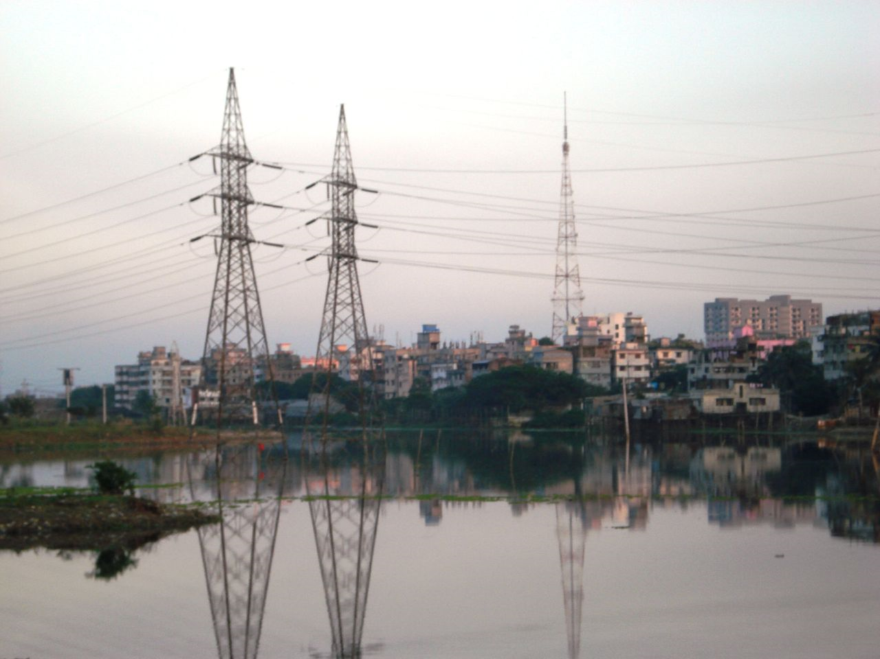
Human Development Index

Slide 22
Alternate way of measuring human development, a figure is produced between 0-1.
This is calculated by using
Life expectancy at birth, as an index of population health and longevity
Knowledge and education, as measured by the adult literacy rate and enrollment in each sector of education.
Standard of living, as indicated by the gross domestic product per capita.

Slide 23
Why the Human Development Index?
It does not rely solely on wealth, it gives an indicator of quality of life by including health and education.
By including education it gives an indication of the country’s future development potential.
It reveals how a country uses it wealth. For example, if a country has a high GNP, but spends little on education, it will have a low HDI.

Slide 24
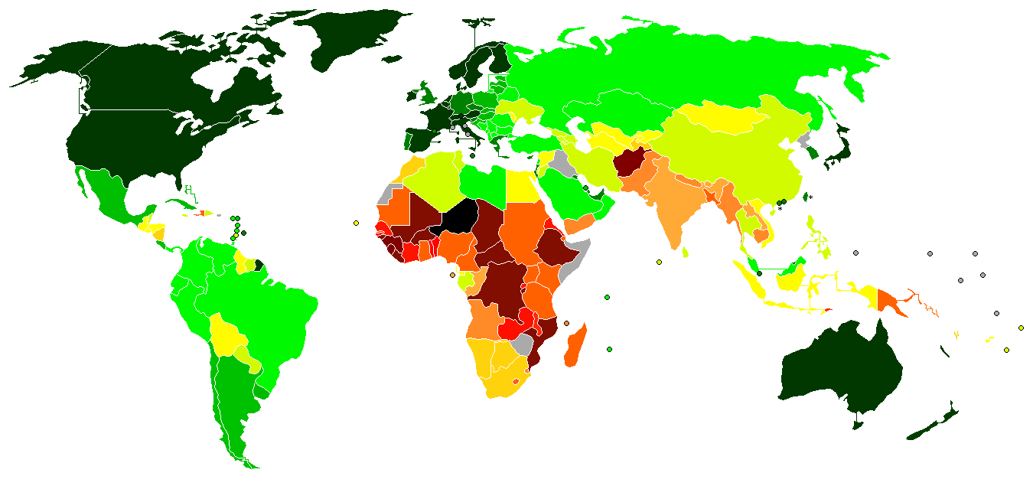
High Development
Moderate Development
Human Development Index-
Low Development
http://en.wikipedia.org/wiki/File:UN_Human_Development_Report_2009.PN

Slide 25
HDI – Top Five
Very High Human Development
1 | Norway | 0.971
2 | Australia | 0.970
3 | Iceland | 0.969
4 | Canada | 0.966
5 | Ireland | 0.965
7- Japan 0.949 146 Bangladesh 0.543
8 – Korea 0.887

Slide 26
HDI – Bottom Five
Low Human Development
5 | Burkina Faso | 0.389
4 | Mali | 0.371
3 | Central African Republic | 0.369
2 | Afghanistan | 0.352
1 | Niger | 0.340

Slide 27
People have been critical of the human development index because
Some countries do not submit data because they are unwilling or not members of the UN. Zimbabwe- 2009.
It puts emphasis again on economics, rather than spiritual and moral development- happiness- should suicide rates be used?
It doesn’t include ecological concerns or the quality of the living environment.
Due to the calculation between 0-1, ‘rich’ countries can do little to improve their ranking in certain categories- despite developments.
Despite being a composite, it adds little to just using the individual statistics.

