Slide 1
Unit 1 Review
Geography its nature and perspectives

Slide 2
Space and Place
Space refers to the geometric surface of the earth
Place is an area of bounded space that is viewed as significant
When this is recognized, we normally assign a toponym (place name)
Places change over time
Sequent occupancy- the succession of groups and cultural influences throughout a place’s history
Place specificity
EX: the place specificity of Santa Fe, New Mexico, is a complex mix of multiple Native American, Spanish colonial, and modern American influences based on past and current societal influences

Slide 3
Scale
Scale is the relationship of an object or place to the earth as a whole
Two types of scale
Map Scale
The ratio of distance on a map to actual distance
Relative Scale
Also known as the scale of analysis (local, regional, global)
Ranges of scales can be varied

Slide 4
Three Types of Region
Vernacular Region
Formal Region
Functional Region

Slide 5
Vernacular Region
Vernacular Region- A place where the language or customs of the people are constant
EX: New England, the Bible Belt, the Deep South

Slide 6
Formal Region
Formal Region is a region with a defined boundary that has a homogeneous characteristic or uniformity
A homogeneous characteristic could be language
EX: In a linguistic region, everyone speaks the same language, however groups of people in the region can be very different culturally
EX: United States, England, Australia

Slide 7
Functional Regions
Functional regions(nodal regions) have a central place(node) that is a point of origin
The influence of this point is strongest in the areas close to the center, and the strength of influence diminishes as distance increases from that point
EX: Market areas; A sports team will have the strongest fan base and media coverage in areas close to their home city. There are fans in other nearby cities, but their numbers decrease as the distance between the two cities increase
Based on a central location

Slide 8
Formal and Functional Regions
Fig. 1-11: The state of Iowa is an example of a formal region; the areas of influence of various television stations are examples of functional regions.

Slide 9
Vernacular Regions
Fig. 1-12: A number of factors are often used to define the South as a vernacular region, each of which identifies somewhat different boundaries.

Slide 10
Regional Boundaries
Culture regions tend to have unclear borders
Political regions have well defined boundaries
Environmental region boundaries are transitional and measureable
EX: The space between the Sahara Desert and the tropical savanna of Africa is known as the Sahel

Slide 11
Location..(Location, Location)
Absolute Location
Relative Location

Slide 12
Absolute Location
Absolute location describes a place using coordinates such as latitude and longitude
Notation
Latitude, Longitude
Degrees can be divided into minutes, and minutes can be divided into seconds
EX: Absolute Location of the United States Capitol Building
38^{O} 53 23 N, 77^{O} 0 32 W
Equator is 0^{O} Latitude
North and South Poles are 90^{O} latitude
Prime Meridian is 0^{O}
When invented, helped British sea captains locate how far east or west they were of Britian

Slide 13
Time Zones
Divided up into 15 degree wide longitudinal zones around the world
Because 360(degrees in a rotation)/24(hours in a day)= 15
Dividing lines between time zones often follow political boundaries, and can occasionally follow local area divisions
Were created during the era of transcontinental railways to standardize time across long east-west train lines

Slide 14
Site and Situation
Site
The physical characteristics of a place
EX: The Acropolis is located on elevated ground
Situation
The place’s interrelatedness with other places
EX. The Situation of Oxford The settlement of Oxford is situated approximately 17miles to the North West of Cambridge and is about 5 miles east of the market town of Huntingdon.

Slide 15
Distance
Distance can be regarded in both absolute and relative terms like scale and location
Linear absolute distance can be measured as Euclidean distance, the straight line of distance from one point to another
Geographers often use the concept of distance decay to explain relative distance
Distance decay is a concept that states the further away different places are from a place of origin, the less likely interaction will be with the original place
Relative distance is expressed by the principle of Tobler’s Law which states that all places are interrelated, but closer places are more related than further ones
When the length of distance becomes a factor that inhibits the interaction between two points, this is known as the friction of distance
EX: When the time and cost of moving a product prevents it from being sold in far away locations

Slide 16
Space-Time Compression
Space-Time Compression is the decreased time and relative distance between places
Technology can reduce the relative distance between places
Transportation such as airplanes or trains can reduce travel time between two distant points and, as a result, increase their interaction
The Internet can also influence space-time compression
The Internet allows people to communicate with people they otherwise wouldn't be able to communicate with

Slide 17
Space-Time Compression, 1492–1962
Fig. 1-20: The times required to cross the Atlantic, or orbit the Earth, illustrate how transport improvements have shrunk the world.

Slide 18
Spatial Interactions
Pattern
Land survey patterns
Diffusion Patterns
Density
Central Places
Core and Periphery

Slide 19
Pattern
Various Terms
Cluster- objects are grouped together on the earth’s surface
Agglomeration- when clustering occurs purposefully around a central point or an economic growth pole
Random pattern- no reason for a particular distribution of a spatial phenomenon
Scattered- objects that are normally ordered but appear dispersed
If a pattern is in a straight line it is linear and if it is wavy it is sinuous(think sine curve)

Slide 20
Township and Range Patterns
After the 1830s, new technology allowed surveyors to divide the land based on lines of longitude and latitude
This produced the geometric shape to many western states of the United States
Nevada, Utah, Colorado, Wyoming etc…

Slide 21
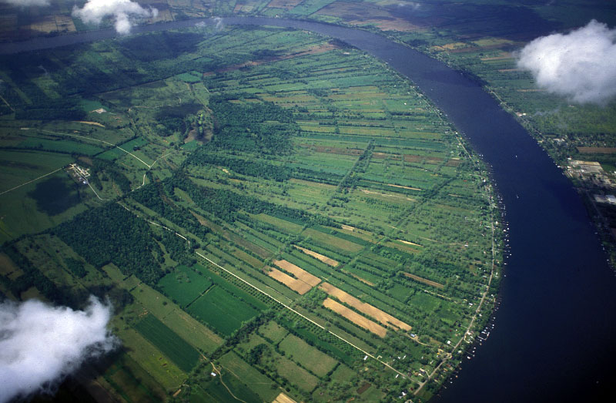
Long Lots Patterns
Former French colonial areas such as Quebec and Louisiana have long-lot patterns
These have a narrow frontage along a road or waterway with a long lot shape behind

Slide 22
Diffusion Patterns
There are various ways and patterns in which human phenomena diffuse spatially or spread across the earth’s surface
Most often we examine how culture, ideas, or technology spread from a point of origin to other parts of the world
That point of origin or place of innovation can be called a hearth

Slide 23
Expansion Diffusion
Originates in a central place and expands outwards in all directions.
Distance does not have to be equal in all directions

Slide 24
Hierarchal Diffusion
Originates in a first-order location and later moves to second-order locations, which move to tertiary-order locations, which move to…
Endless cycle

Slide 25
Relocation Diffusion
Begins at a point of origin and then crosses a significant physical barrier, and later relocates on the other side
Can often influence and modify the items being diffused

Slide 26
Contagious Diffusion
Begins at a point of origin, then moves outward to nearby locations, especially on adjoining transportation lines
EX: Disease
EX2: News in rural areas

Slide 27
Stimulus Diffusion
A general or underlying principle diffuses and then stimulates the creation of new products or ideas

Slide 28
Density
Number of objects per square unit of distance is known as arithmetic density
Agricultural density is the people per square unit of land actively under cultivation
Physiologic density measures the number of people per square unit of arable land

Slide 29
Core and Periphery
Many different regional, cultural, economic, political, and environmental phenomena and human activities display some sort of core and periphery relationship
A country’s capital is the core of its political landscape
The core does not have to be in the center of the landscape

Slide 30
Map Types
Topographic Maps
Thematic Maps
Chloropleth Maps
Isoline Maps
Dot Density Maps
Flow-line Maps
Cartograms

Slide 31
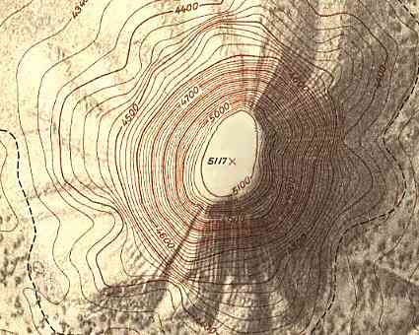
Topographic Maps
Show the contour lines of elevation
Highly accurate in location and topography
Used for engineering surveys and land navigation

Slide 32
Thematic Maps
Number of different types of maps are thematic(All mentioned following this slide are Thematic Maps)
Each one expresses a particular subject and does not show land forms for other features

Slide 33
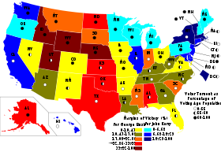
Chloropleth Maps
Expresses geographic variability of a particular theme using color variations
Root word “chloro”
These variations can be expressed using colorized symbols, contour areas filled with different colors, or polygons denoting country boundaries to express the variability in map data
Map shown is based on 2004 presidential election statistics

Slide 34
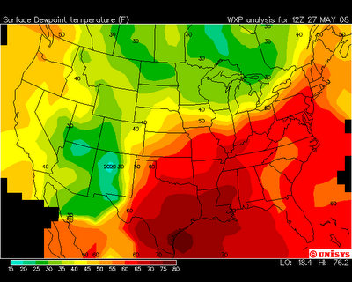
Isoline Maps
Calculate data values between points across a variable surface
Series of contour lines can be drawn to show changes in data
Weather maps showing temperature contours are the most common type of isoline map

Slide 35
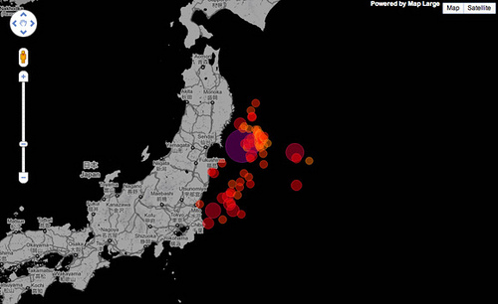
Dot Density Maps
Use dots to express the volume and density of a geographic feature
Dots can represent statistics such as population density, or the frequency of phenomena
Map shown is the volume of earthquakes in Japan following the 2011 Tohoku Earthquake

Slide 36
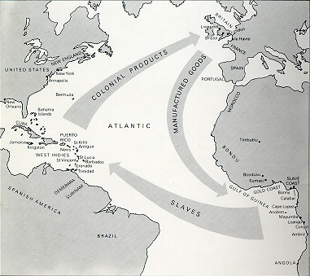
Flow-line Maps
Use lines of varying thickness to show the direction and volume of a particular geographic movement pattern
Map shown is Triangular Trade

Slide 37
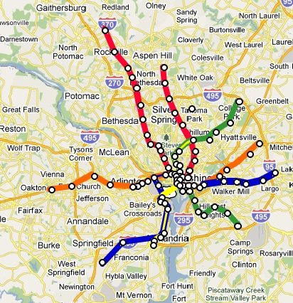
Cartograms
Use simplified geometries to represent real-world places
More about the data expressed than about landscape
Often used in subway systems

Slide 38
Projections
A map projection's level of accuracy is based upon two concepts
Area preservation
Shape preservation

Slide 39
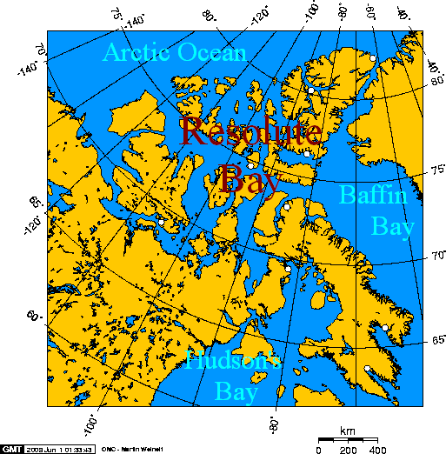
Equal-area Projections
Attempt to maintain the relative spatial science and the areas on the map
These projections can distort the shape of polygons
EX: Lambert Projection
Distorted size of northern Canadian islands

Slide 40
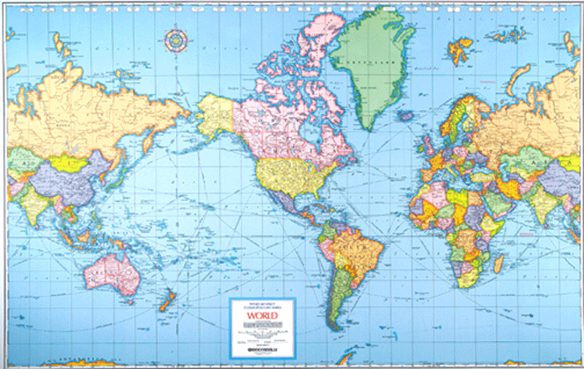
Conformal Projections
Attempt to maintain the shape of polygons on the map
Downside= distorts the relative area from one part of the map to another
EX: Mercator projection
Distorts Greenland’s size

Slide 41
Geographic Technology
Geographical Information Systems(GIS)
Global Positioning Systems(GPS)
Remote Sensing

Slide 42
Geographical Information Systems(GIS)
Uses one or more data layers in a computer program capable of spatial analysis and mapping
Data layers are numerical, coded, or textual data that is attributed to specific geographic coordinates or areas
Date between layers can be analyzed spatially
Used when calling 911

Slide 43
Global Positioning Systems(GPS)
Utilizes a worldwide network of satellites
A GPS receiver is able to triangulate a coordinate location and display map data for the user

Slide 44
Remote Sensing
Aerial photography and satellite-based remote sensing make up a large amount of the geographic and GIS data used today
Aerial photographs have been used since the 1800s
Remote sensing satellites have been used since the 1970s
Remote sensing can record data from the earth’s surface
Data not only includes visual light wavelengths, but infrared and radar information
Aerial photographs can also be used to revise topographic map data without sending out a survey team to gather new data
Infrared satellite imagery is commonly used to determine the health of vegetation on the earth’s surface
Helps to maintain stable prices for farm goods such as milk, eggs, and bread

