Slide 1
Political
Chapter 8

Slide 2
How is Space Politically Organized into States and Nations?
Key Question:

Slide 3
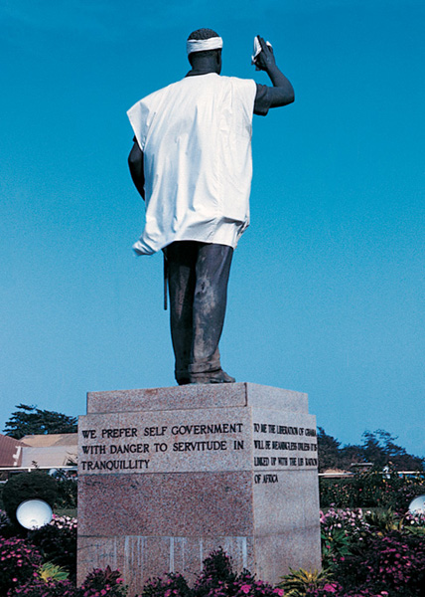
Political Geography
Political Geography – the study of the political organization of the world.

Slide 4
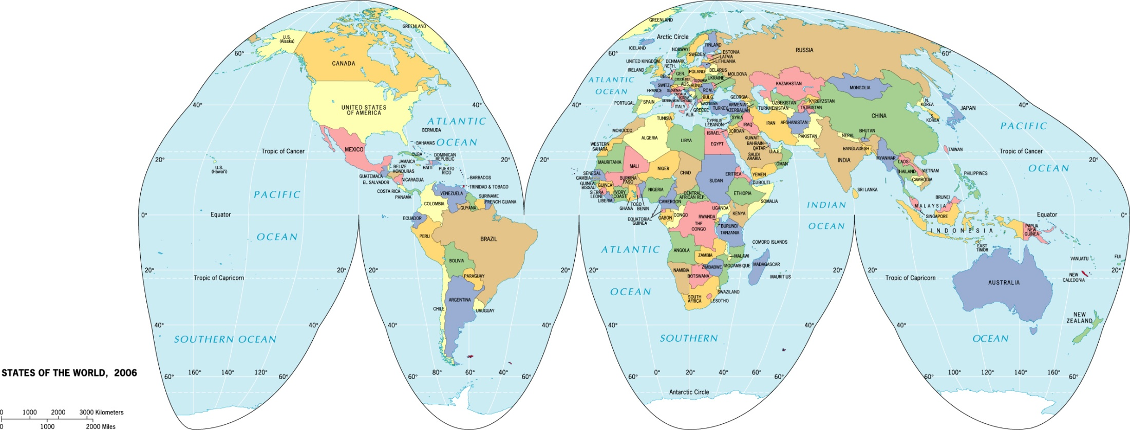
State
State – a politically organized territory with a permanent population, a defined territory, and a government. To be a state, an entity must be recognized by such by other states.

Slide 5
Territoriality –
“the attempt by an individual or group to affect, influence, or control people, phenomena, and relationships, by delimiting and asserting control over a geographic area.” – Robert Sack
Sovereignty –
having the last say over a territory – legally.
Territorial Integrity –
a government has the right to keep the borders and territory of a state in tact and free from attack.

Slide 6
The Modern State Idea
The idea of a state that is tied to a particular territory with defined boundaries came out of Europe and diffused through:
mercantilism
colonialism

Slide 7
Nations
Nation – a culturally defined group of people with a shared past and a common future who relate to a territory and have political goals.
People construct nations to make sense of themselves.
Nations are “imagined communities”
-Benedict Anderson
imagined = you will never meet all the people in your nation
community = you see yourself as part of it

Slide 8
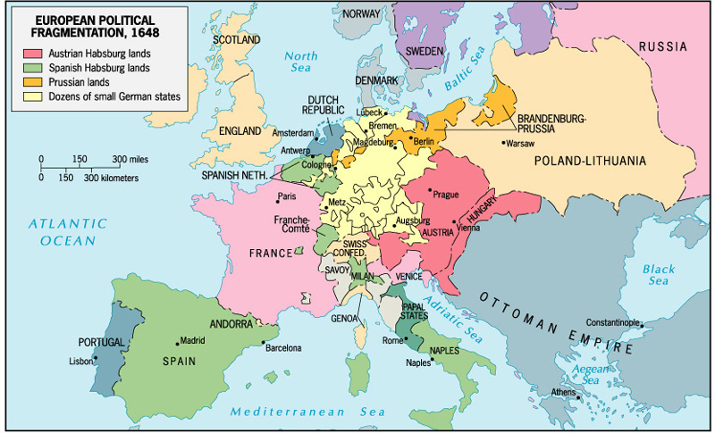
The nations we perceive as “natural” and “always existing” are relatively recent phenomena.
In 1648, Europe was divided into dozens of small territories.

Slide 9
Nation-State
Nation-State –
a politically organized area in which nation and state occupy the same space.
Where did the ideal of the nation-state originate?
How did the ideal of the nation-state diffuse?
Are there any nation-states in the world today?

Slide 10
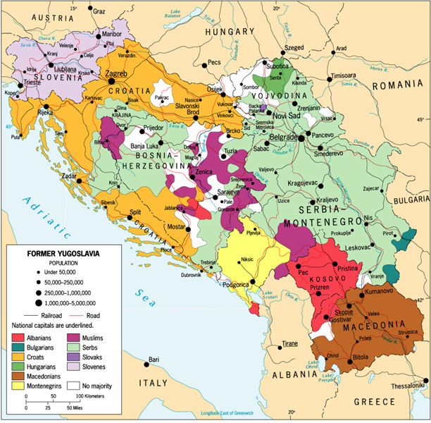
Multinational State –
A state with more than one nation.
The Former Yugoslavia

Slide 11
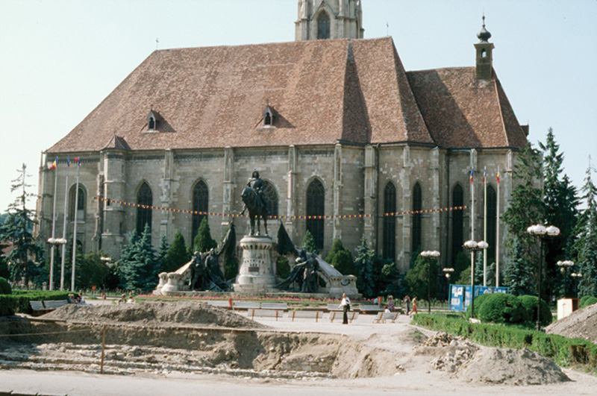
Multistate Nation –
A nation with more than one state.
Transylvania – homeland for both Romanians and Hungarians.

Slide 12
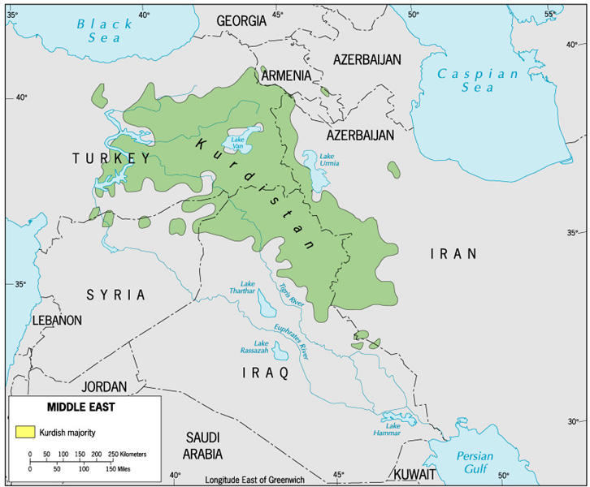
Stateless Nation – a nation without a state

Slide 13
Nation and Territory
“The control and maintenance of a territory is as crucial as the control and maintenance of a national language, religion, or particular way of life. Indeed, a language, religion, or way of life is difficult to maintain without control over territory.”
- George White

Slide 14
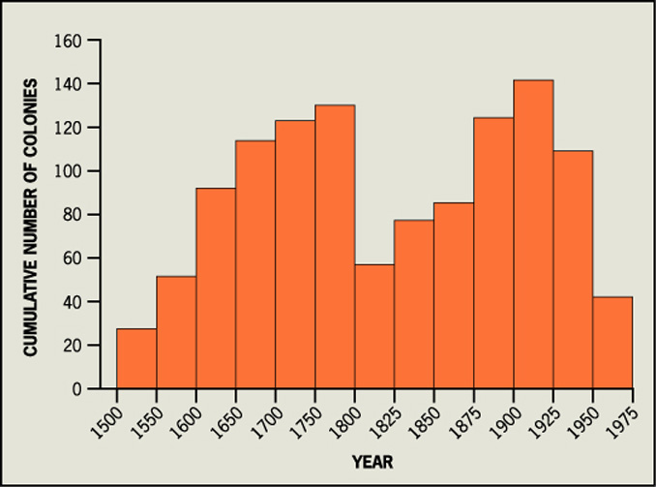
European Colonialism and the Diffusion of the Nation-State Model
Colonialism -
a physical action in which one state takes over control of another, taking over the government and ruling the territory as its own.
Two Waves of European Colonialism:
1500 - 1825
1825 - 1975

Slide 15
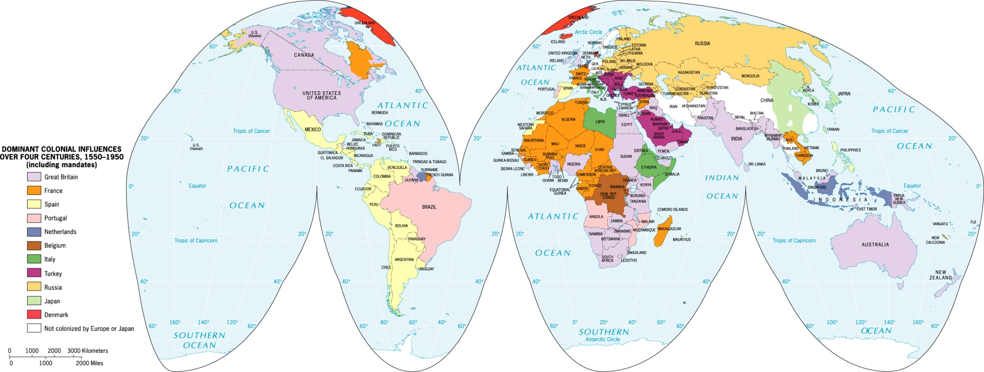
Dominant Colonial Influences, 1550-1950
This map shows the dominant influence, as some places were colonized by more than one power in this time period.

Slide 16
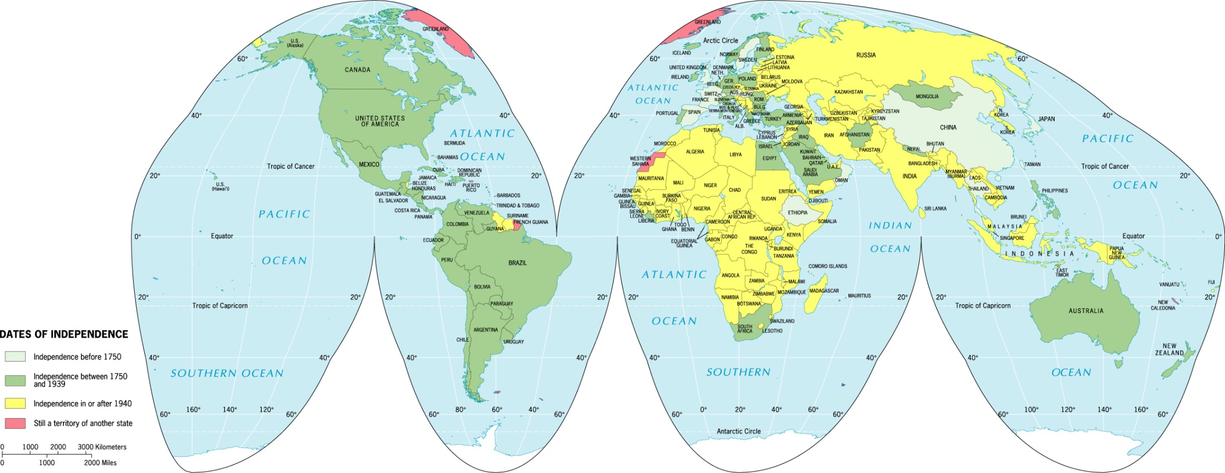
Two Waves of Decolonization
First wave – focused on decolonization of the Americas
Second wave – focused on decolonization of Africa and Asia

Slide 17
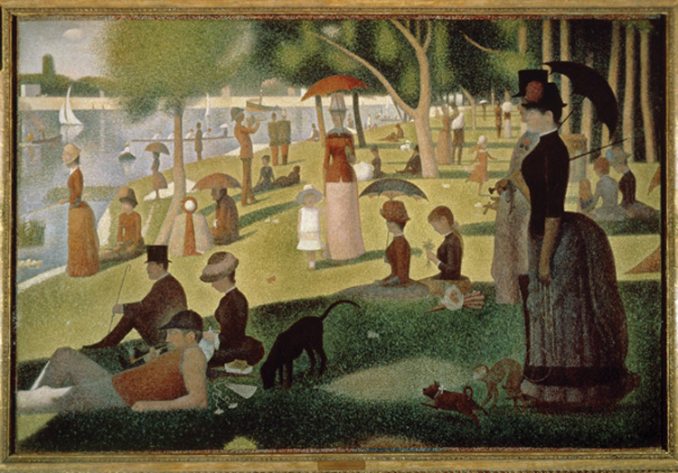
The Capitalist World-Economy
The World-Economy
is more than the sum of its parts. It is composed of “dots” but we must also understand the “whole.”
Sunday on La Grande Jatte by Georges Pierre Seurat

Slide 18
Immanuel Wallerstein’s World-Systems Theory:
The world economy has one market and a global division of labor.
Although the world has multiple states, almost everything takes place within the context of the world economy.
The world economy has a three-tier structure.

Slide 19
Construction of the World Economy
Capitalism – people, corporations, and states produce goods and services and exchange them in the world market, with the goal of achieving profit.
Commodification – the process of placing a price on a good and then buying, selling, and trading the good.
Colonialism – brought the world into the world economy, setting up an interdependent global economy.

Slide 20
Three Tier Structure
Core
Processes that incorporate higher levels of education, higher salaries, and more technology
* Generate more wealth in the world economy
Periphery
Processes that incorporate lower levels of education, lower salaries, and less technology
* Generate less wealth in the world economy
Semi-periphery
Places where core and periphery processes are both occurring. Places that are exploited by the core but then exploit the periphery.
* Serves as a buffer between core and periphery

Slide 21
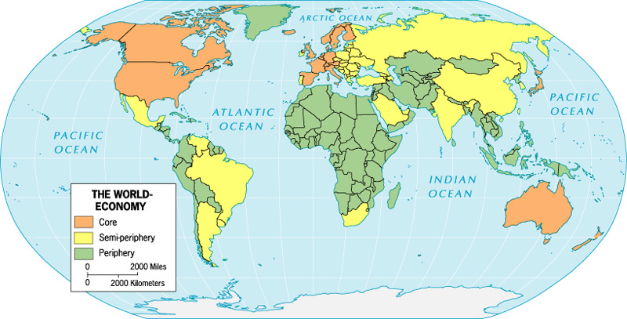

Slide 22
Imagine you are the leader of a newly independent state in Africa or Asia. Determine what your government can do to build a nation that corresponds with the borders of your state. Consider the roles of education, government, military, and culture in your exercise in nation-building.

Slide 23
How do States Spatially Organize their Governments?
Key Question:

Slide 24
Forms of Government
Unitary – highly centralized government where the capital city serves as a focus of power.
Federal – a government where the state is organized into territories, which have control over government policies and funds.

Slide 25
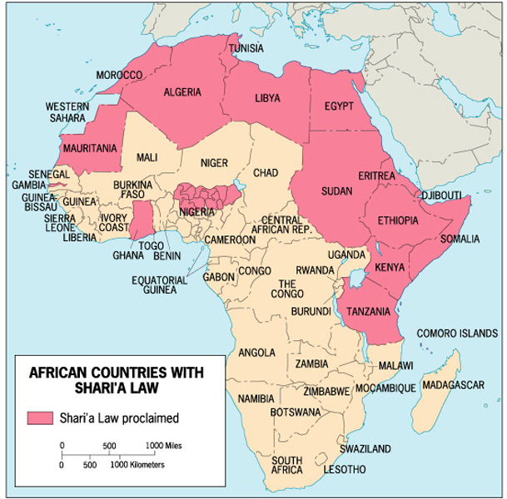
Nigeria’s Federal Government –
Allows states within the state to determine
whether to have Shari’a Laws
Shari’a Laws
Legal systems based on traditional Islamic laws

Slide 26
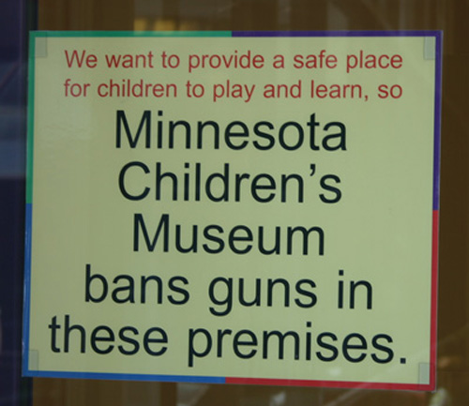
The U.S. Federal Government –
Allows states within the state to determine “moral” laws such as death penalty, access to alcohol, and concealed weapons.
Minnesota’s concealed
weapons law
requires the posting of signs such as this on buildings that do not allow concealed weapons.

Slide 27
Devolution –
Movement of power from the central government to regional governments within the state.
What causes devolutionary movements?
Ethnocultural forces
Economic forces
Spatial forces

Slide 28
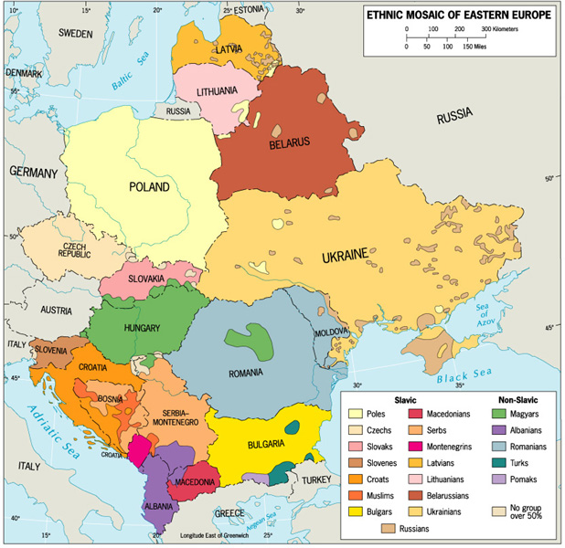
Ethnocultural Devolutionary Movements
Eastern Europe
devolutionary forces since the fall of communism

Slide 29
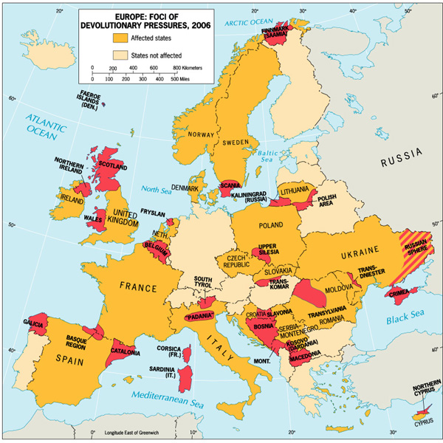

Slide 30
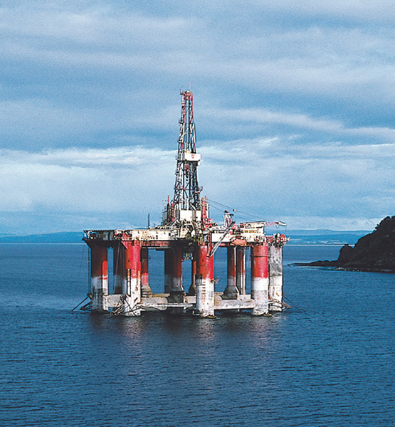
Ethnocultural Devolutionary Movements
Scotland
rise in independence movement is coupled with:
- European Union
- Scotland’s oil resources

Slide 31
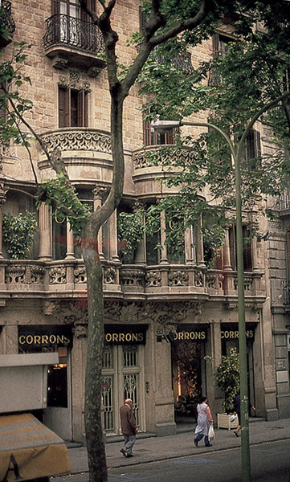
Economic Devolutionary Movements
Catalonia, Spain
Barcelona is the center of banking and commerce in Spain and the region is much wealthier than the rest of Spain.

Slide 32
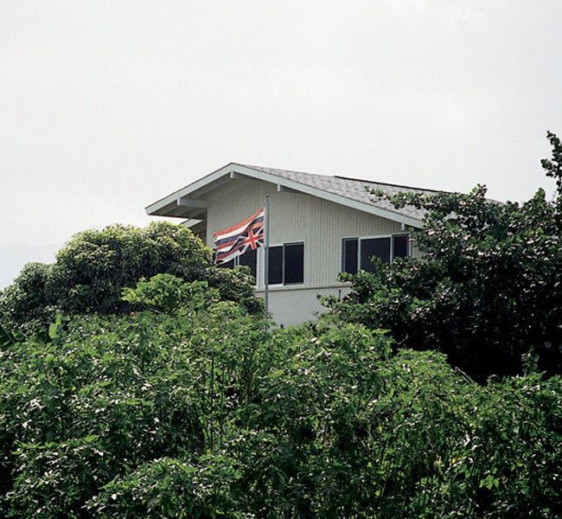
Spatial Devolutionary Movements
Honolulu, Hawai’i
A history apart from the United States, and a desire to live apart in order to keep traditions alive.

Slide 33
Electoral Geography
A state’s electoral system is part of its spatial organization of government.
In the United States:
- territorial representation
- reapportionment
- voting rights for minority populations

Slide 34
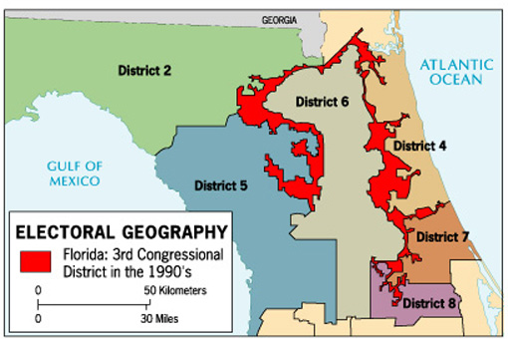
Gerrmandering – drawing voting districts to benefit one group over another.
Majority-Minority districts drawn so that the majority of the population in the district is from the minority.

Slide 35
Choose an example of a devolutionary movement and determine whether autonomy (self-governance) for that region would benefit the autonomous region, the country in which it is located, or both.

Slide 36
How are Boundaries Established, and Why do Boundary Disputes Occur?
Key Question:

Slide 37
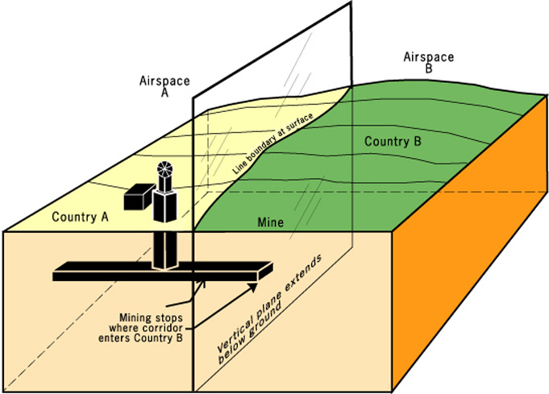
Boundary – a vertical plane that cuts through the rocks below and the airspace above, dividing one state territory from another.

Slide 38
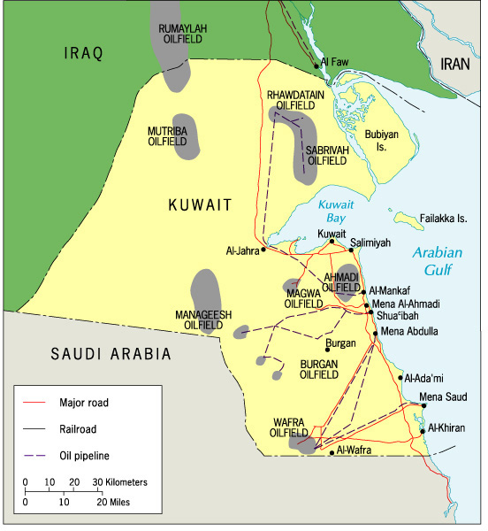
Boundaries often divide resources, such as oil between Kuwait and Iraq

Slide 39
Establishing Boundaries
Define
Delimit
Demarcate
Administrate

Slide 40
Types of Boundaries
Geometric boundaries – based on grid systems
eg. Boundary between the US and Canada
Physical-political boundaries – follow an agreed-upon feature in the physical geographic landscape.
eg. Boundary between the US and Mexico

Slide 41
People used to think physical-political boundaries were more stable than geometric boundaries. Through many studies of many places, political geographers have confirmed this idea is false. Construct your own argument explaining why physical-political boundaries can create just as much instability as geometric boundaries.

Slide 42
How do Geopolitics and Critical Geopolitics Help us Understand the World?
Key Question:

Slide 43
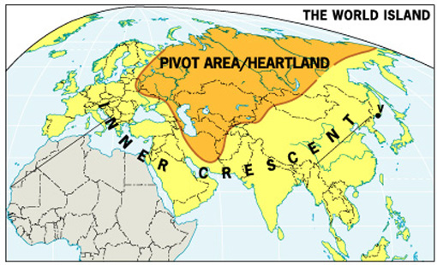
Geopolitics
Geopolitics – the interplay among geography, power, politics, and international relations.

Slide 44
Classical Geopolitics
German School
eg. Ratzel’s organic state theory
British / American School
eg. Mackinder’s Heartland Theory

Slide 45
Mackinder’s Heartland Theory: “Who rules East Europe commands the Heartland Who rules the Heartland commands the World Island Who rules the World Island commands the world”

Slide 46
Critical Geopolitics
The idea that intellectuals of statecraft construct ideas about places, these ideas influence and reinforce their political behaviors and policy choices, and these ideas affect how we, the people, process our own notions of places and politics.

Slide 47
Us versus Them
Terrorists “come from diverse places but share a hatred for democracy, a fanatical glorification of violence, and a horrible distortion of their religion, to justify the murder of innocents. They have made the United States their adversary precisely because of what we stand for and what we stand against.”
“They [the terrorists] stand against us because we stand in their way.”
“I’ve said in the past that nations are either with us or against us in the war on terror.”

Slide 48
Us versus Them
Terrorists “come from diverse places but share a hatred for democracy, a fanatical glorification of violence, and a horrible distortion of their religion, to justify the murder of innocents. They have made the United States their adversary precisely because of what we stand for and what we stand against.”
“They [the terrorists] stand against us because we stand in their way.”
President George W. Bush
“I’ve said in the past that nations are either with us or against us in the war on terror.”
President George W. Bush
President William J. Clinton

Slide 49
Geopolitical World Order
Temporary periods of stability in how politics are conducted at the global scale.
bi-polar
multi-polar
unilateralism
Will individual states remain the dominant actors in a future geopolitical world order?

Slide 50
Read a major newspaper (in print or online) and look for a recent statement by a world political leader regarding international politics. Using the concept of critical geopolitics, determine what view of the world the world leader has – how he/she defines the world spatially.

Slide 51
What are Supranational Organizations, and What is the Future of the State?
Key Question:

Slide 52
Supranational Organizations
A separate entity composed of three or more states that forge an association and form an administrative structure for mutual benefit in pursuit of shared goals.
* How many supranational organizations
exist in the world today?

Slide 53
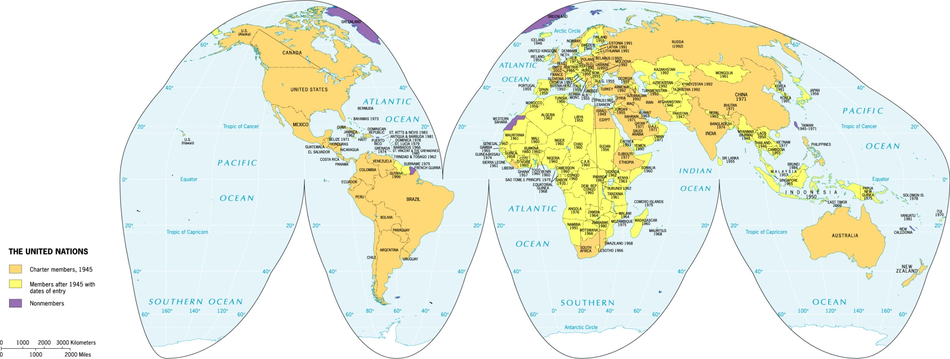
Global Scale – The United Nations

Slide 54
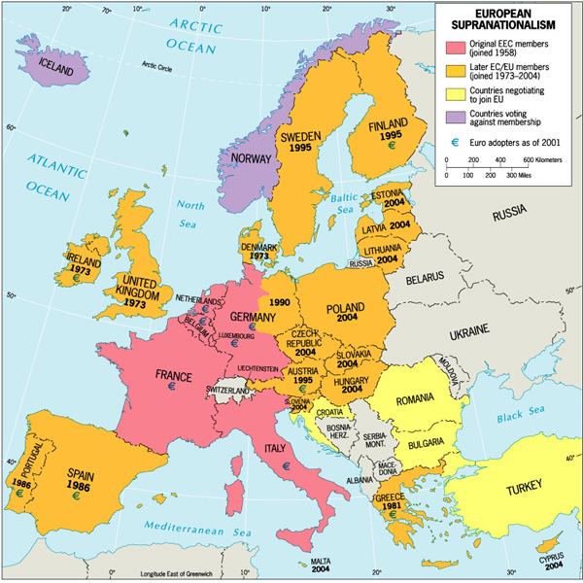
Regional Scale – The European Union

Slide 55
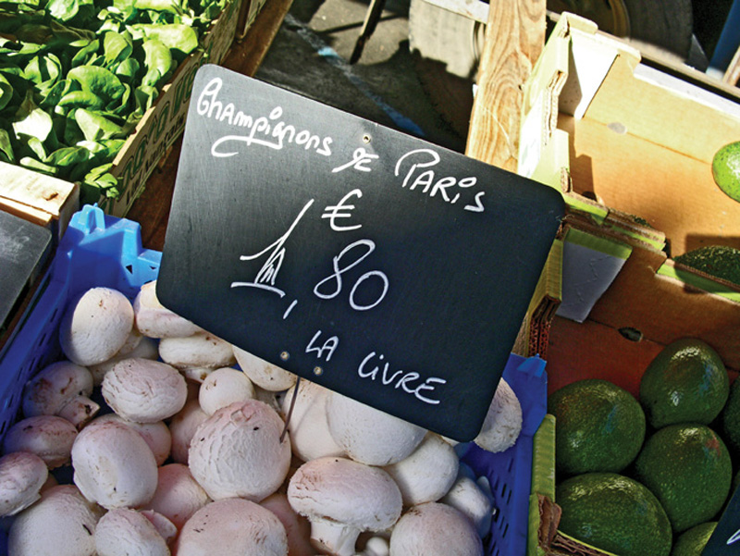
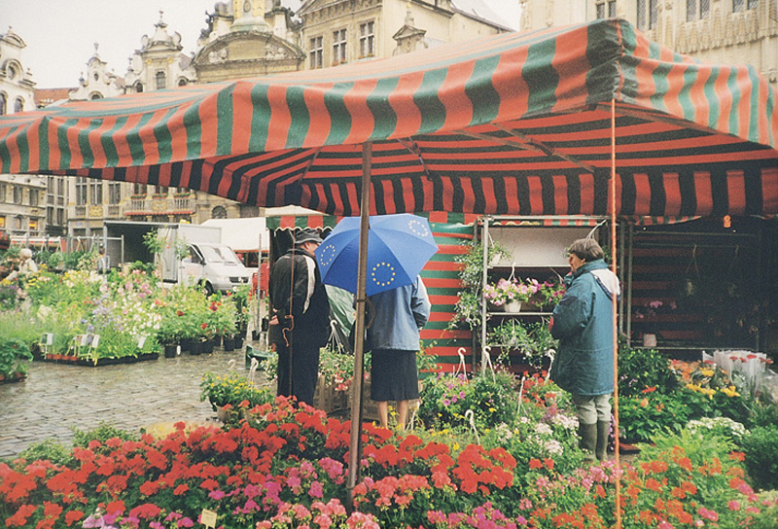
How does Supranationalism affect the State?
identities
economics

Slide 56
In 2004, the European Union welcomed 10 additional states, and in 2007, the European Union plans to welcome 2 more states. Examine the European Union website. Read about the European Union’s expansion and what is going on in the European Union right now. Consider how complicated it is for the European Union to bring together these many divergent members into one supranational organization.

